Slide 1
Cyclistic Subscription Analysis
As of December 2021

Slide 2
Presentation Contents
01
02
03
04
Purpose Statement
Analysis
Conclusion
Appendix
Notes:
I’ll throw in a hypothesis somewhere in the analysis

Slide 3
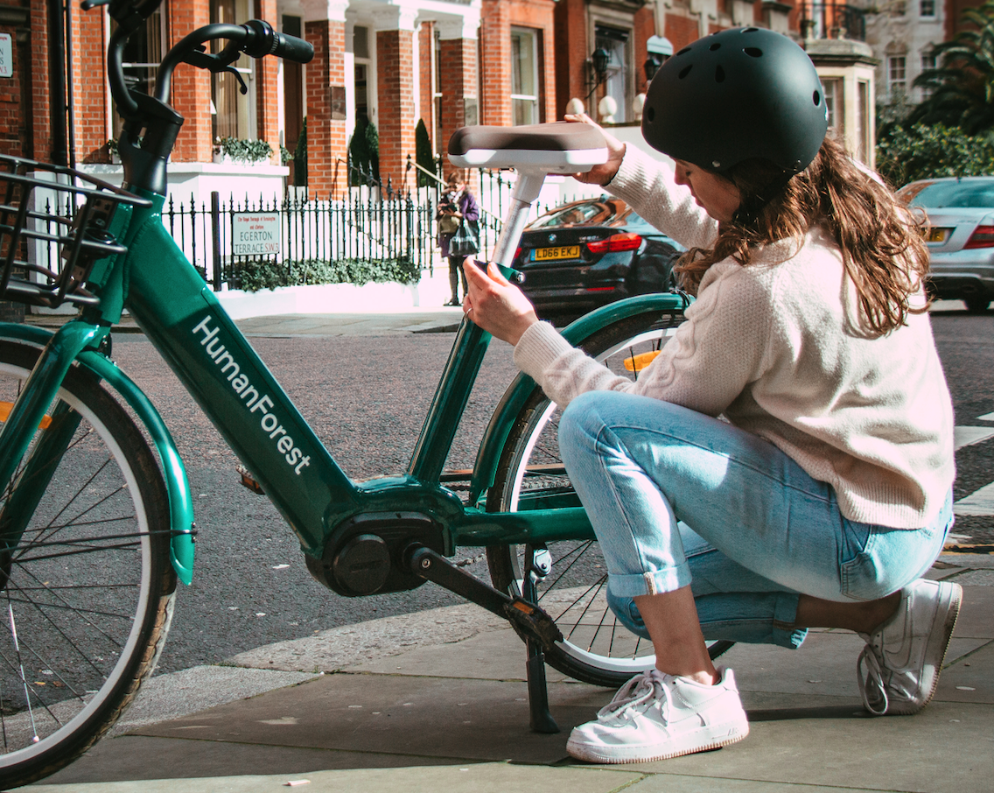
Objective
Determine what marketing strategies can be used to convert casual riders into annual members.
How casual riders use Cyclistic’s bikes differently compared to annual members.
Notes:
Annual members are more profitable
We’ll do this by looking into the route and time preferences between the two using the past 12 months of data

Slide 4

02
Analysis

Slide 5
5,607,239
Rides in the past 12 months
Notes:
692 stations, armada of 5800 bikes spread across Chicago

Slide 6
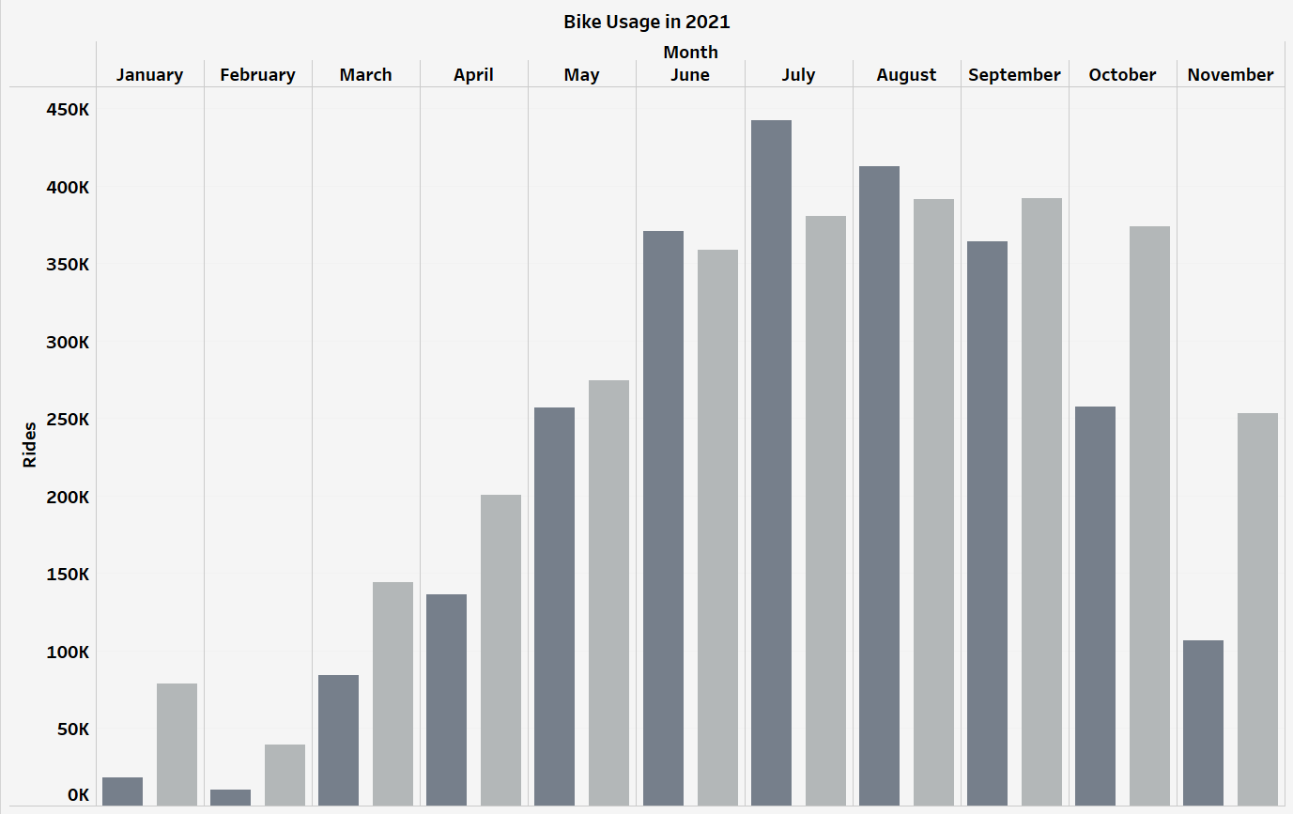

Rides are going down
Less casual members lately
Notes:
Distribution this year….
Started very low but went all the way up to 440k mid year, then it went down…. A lot less casual members, which is what we want….

Slide 7
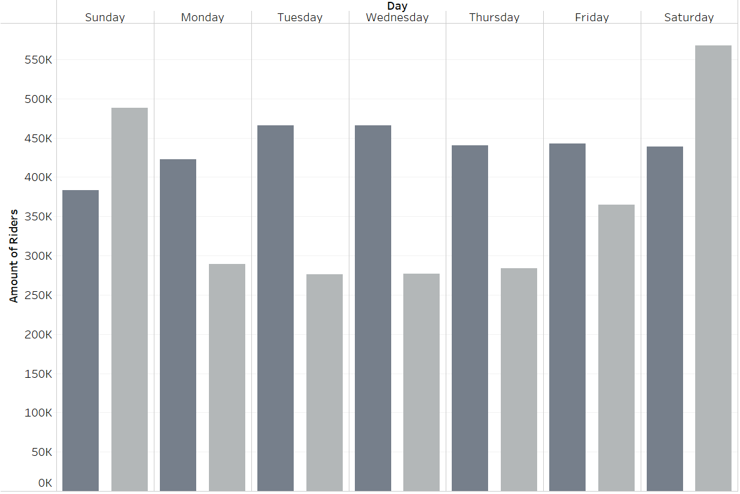

High casual riders on the weekends
High annual members during workdays
Notes:
Next we’ll look at the daily distribution

Slide 8
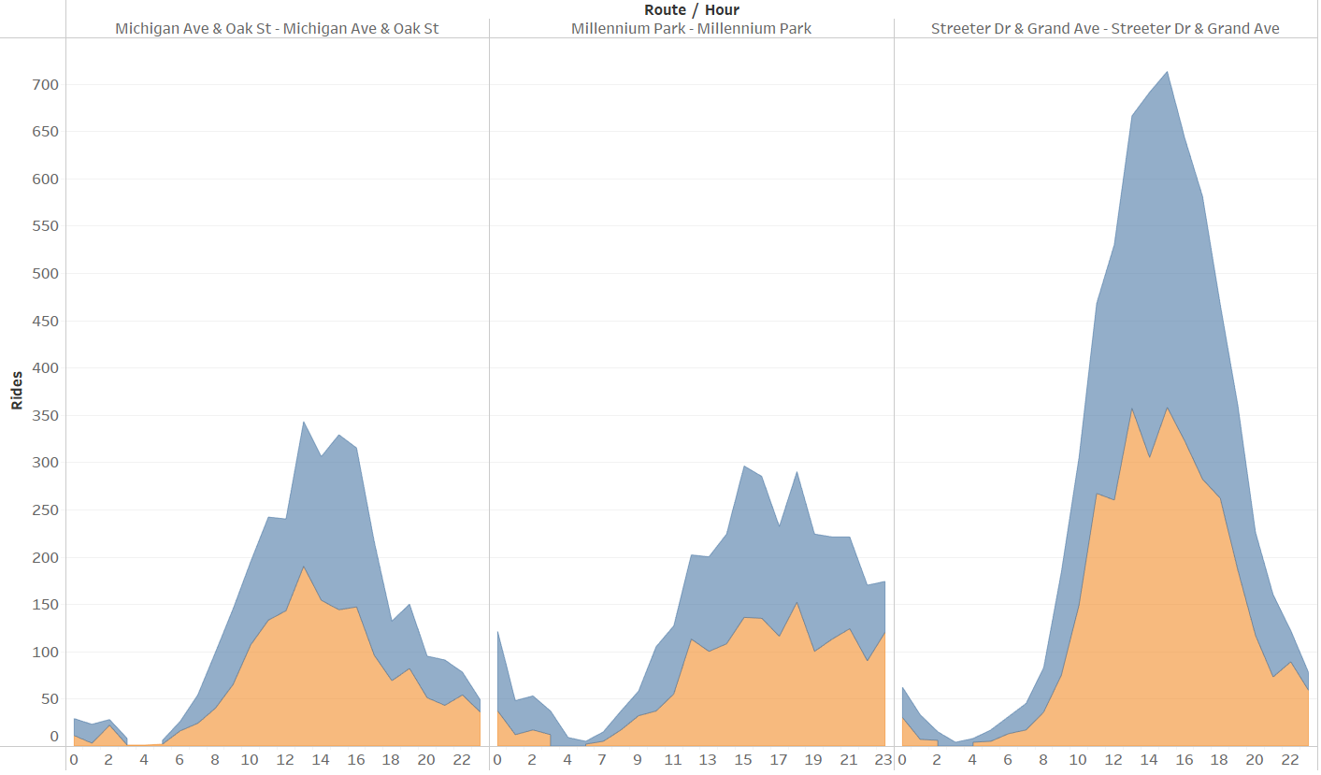

Top Three Routes:
Michigan Ave & Oak St-
Millennium Park-
Streeter Dr & Grand Ave-
Analyses:
More rides on Sunday
Peak rides at noon
Notes:
We then filtered out the annual members to see which routes are most commonly taken by casual riders
The top three are…. They all go back to where they started: weekend fun ride around
Peak rides happen around 10am-6pm (averaging at 3pm)

Slide 9
03
Conclusion

Slide 10
3pm on a Sunday would be the best time to advertise an annual membership to casual riders taking the Streeter Dr & Grand Ave loop
Notes:
They would be happy, probably does it every weekend, why not apply for an annual membership.
This would be the best way to reach the most amount riders.

Slide 11
Thank You

